Slide 1

Automated Deployment of Static Portfolio Website Using GitHub Actions
Sit Dolor Amet

Slide 2
Problem Statement
Manual deployment of static websites is error-prone and time-consuming.
Developers often forget deployment steps or make mistakes during updates.
CI automation eliminates human errors and ensures consistent delivery.
In modern development, speed and accuracy are essential — GitHub Actions helps achieve this.

Slide 3
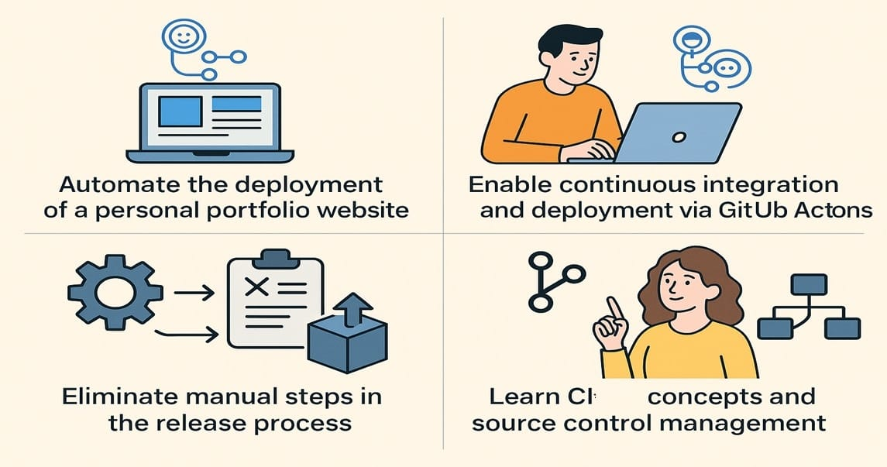
Project Objectives
Automate the deployment of a personal portfolio website.
Enable continuous integration and deployment via GitHub Actions.
Eliminate manual steps in the release process.
Learn CI concepts and source control management.

Slide 4
Tools & Technologies Used
CI Tools : GitHub Actions
Version Control: Git, GitHub
Deployment Platform: GitHub Pages
Languages/Technologies: HTML, CSS
Git hub
html
css

Slide 5
CI Architecture
Developer → Git Commit → Push to Main → GitHub Actions Workflow → Build & Deploy → GitHub Pages
Source Control (GitHub)
Workflow Trigger on Push
Automated Build (optional for static)
Deployment to GitHub Pages

Slide 6
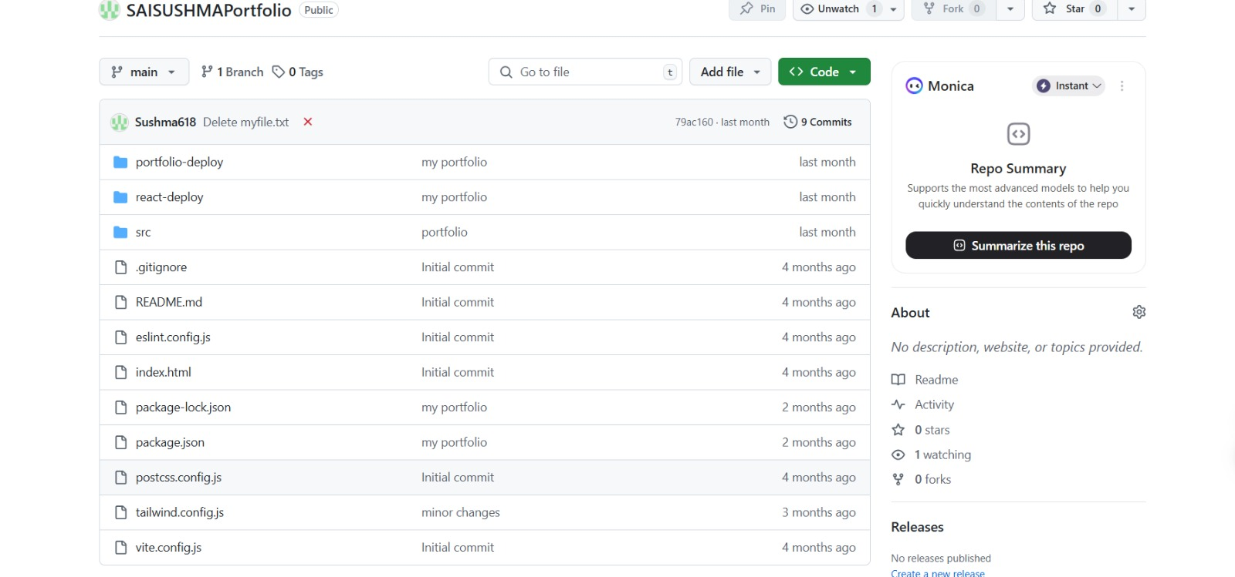
Implementation Details

Slide 7
DevOps Principles in our Project
Automation: GitHub Actions automate the deployment.
Continuous Delivery: Every push triggers an update.
Feedback Loop: GitHub Actions provide logs for each step.
Collaboration: Git enables code sharing and reviews.
Simplicity: No complex server setup — just push and deploy.

Slide 8
Challenges Faced
Initial setup of GitHub Actions syntax
Directory path issues for deployment
Handling build errors due to missing folders
Understanding CI concepts as a beginner

Slide 9
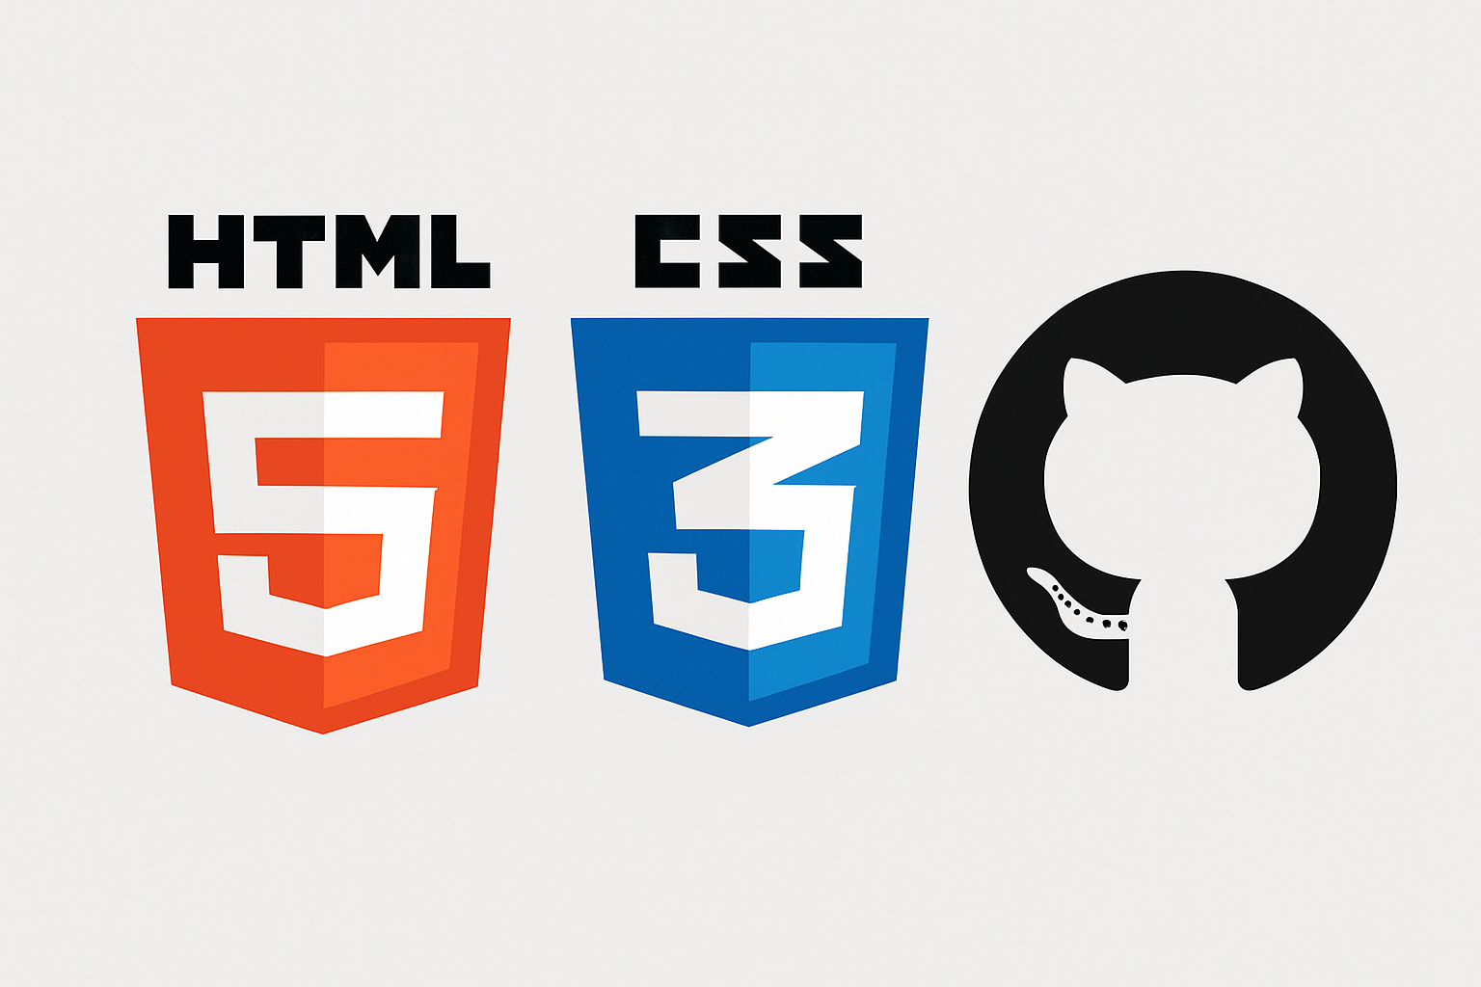
Skills Acquired
Git & GitHub proficiency
CI pipeline basics
Debugging automation workflows
Static site deployment and maintenance

Slide 10
Results & Output
Deployment Success Rate: 100% after setup
Error Reduction: No manual deployment errors
Build Logs: Available in GitHub Actions
Live Link: https://github.com/Sushma618/SAISUSHMAPortfolio
Efficiency: Time-saving and always live

Slide 11
Future Scope
Add unit tests (e.g., HTML/CSS validators)
Integrate Slack notifications for deployment updates
Optimize workflow with build steps (e.g., using Jekyll/React later)
Add custom domain and analytics

Slide 12
Conclusion
Successfully implemented a fully automated deployment pipeline
Learned core CI and DevOps practices
Improved confidence in Git, GitHub, and automation workflows
Gained hands-on experience with modern development practices

